Slide 1
Enterprise DevOps Assessment
Kimberly-Clark Cognizant
Nov 2017

Slide 2
Cognizant’s Proprietary Notice
The data furnished within this presentation shall not be disclosed outside of Kimberly-Clark and shall not be duplicated, used or disclosed in whole or part for any purpose other than to evaluate our assessment outcome. This restriction does not limit Kimberly-Clark’s right to use information contained in the presentation if it is obtained from another source without restriction. Cognizant will consider all written and justified requests and exception to this notice.
© Copyright Cognizant Technology Solutions 2017

Slide 3
Assessment Summary

Slide 4
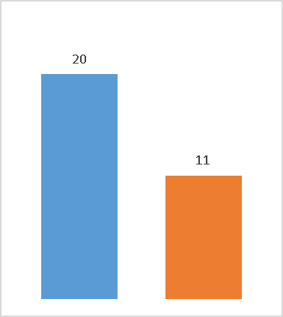
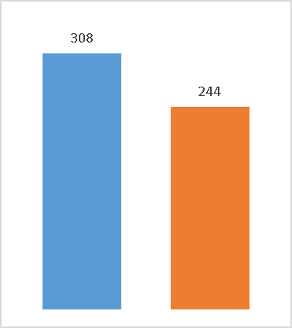
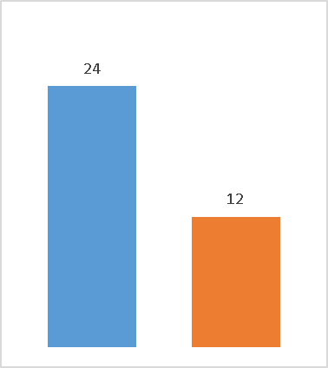
Assessment Summary
Executive Summary: Traditional SDLC and Release Management across all portfolio (SAP, .NET, Web, Mobile, Analytics and others) is constrained by lack of support for modern DevOps practices and development tools. Moreover development and testing at K-C currently involves multiple dedicated teams, each with long release cycles and multiple manual efforts. K-C could significantly benefit from implementing a DevOps culture as well as considering modernizing applications with NextGen DevOps.
Top Challenges & Issues
Slow speed of change across different technology stacks - long process wait times & release cycles
Inefficient test processes, difficulty building test systems and assessing the impact of changes on testing
Manual development & test processes; lack of automation for repetitive workloads
Lack of actionable metrics and data driven decisions for application development
Lack of security first mindset for application development
Investment Opportunities / Proposed Solution(s)
SDLC standardization via dev/test templates, toll gates checklists & metrics
Redefine software engineering practices. Bake application security natively in SDLC
Unify release management processes, governance and workflows
Test automation & Automated Test data management
Define KC impact metrics. Actively measure, track, report and visualization in real time
Actively embrace application modernization. Reengineer to cloud-native on PaaS
Key Benefits & Outcomes
Faster, predictable and frequent releases – increased release velocity
Defect reduction & avoidance earlier in SDLC via stringent quality gates ; quality, risk, coding standards and test coverage integrated into SDLC
Decreased development effort through higher code reuse and automation - higher team productivity
Data driven decisions in SDLC and process insights with metrics
Modernize application tech stack to support business agility and lower TCO
Expected Savings & Gains (projected based on Cognizant best practices)
45%
21%
50%
Release Time (Weeks)
Productivity Gain (Dev-Test Activities)
Productivity Gain (Release Activity )

Slide 5
What we heard: Representative Verbatim Comments From Interviews
“I Wish we could go Agile” | “Security is an afterthought at K-C”
“Test Automation scripts were created 5 years ago and were never maintained “ | “There are no BRD templates and requirements are sometimes done through Emails”
“We have JIRA but only using it for effort management not anything else “ | “Tollgates are within IT only and not documented properly as well”
“We can not use Agile terminology with our Business” | “Some of the groups don’t have robust processes”
“Our test Data is Terrible” | “Over the time coding standards have gotten worse”
“Gathering business requirements are pain sometime due to lack of SME availability” | “No way to measure the effectiveness of release for business”
“No control on demand vs capacity” | “No traceability or tracking of security related changes”

Slide 6
What we heard: Representative Verbatim Comments From Interviews
“Development instances are never refreshed, so unit test scenarios have to be created, sometimes manually, to be able to perform unit test” (SAP) | “Most of the testing is done manually. We have a testing automation tool called Worksoft Certify, but as discussed in the meeting, the effort to maintain test scripts was way beyond the benefit of its usage.”
“There are no unit testing tools. Everything is done manually.” | “It takes days to create a new instance of SAP from a production copy”
“I think the business is looking for more agility and speed in delivery so that they can react faster to the market needs.” | “Agilish !”
“Work with teams to have embrace “Digital Vision” | “Consistent & frictionless UX”
“Need common Repeatable End-to-End services model” | “Want to move towards Product Delivery model”
“Virtual Forge helped but not used widely” | “We have started doing Product based development but not used widely”
“Leadership is unhappy with the velocity” | “Can we not cut the cord for our legacy apps and do cloud native apps to do faster realiztion”

Slide 7
4x4x4 OneDevOpsTM Maturity Continuum
DevOps Maturity
L1. Adhoc
L2. Defined
L3. Embracing
L4. Established
Portfolio Strategy
Drive IT portfolio to business innovation
Build what the business needs, when the business needs it
Enhance on demand, with minimum costs and effort
Resolve defects and incidents faster, cheaper, better
Application Development
Application Enhancement
Business Value Streams
Application Support
Realization Vectors
Vision
Strategy
Capability
Execution
Current K-C Portfolio Maturity is between L1 and L2 based on different realization vectors
Assessment Focus

Slide 8
DevOps Way of Working Scoring for K-C Portfolios
Portfolio | Score
SAP | 2.1
Web/Digital | 3.0
Analytics | 1.4
Cloud | 1.6
Ratings Based on Maturity Scale of 1 - 5

Slide 9
Solution Approach for Transforming K-C to mature DevOps Enabled Organization
Transforming into a more mature product engineering & software delivery organization
4. Embrace Enterprise Application Modernization
3. Accelerate DevOps Adoption
Build all new applications with cloud native/PaaS architecture utilizing advanced engineering practices
Modernize high business value applications to cloud native/PaaS architecture
Establish pod based application development teams with full stack engineers
Integrate app development, app testing and enhancements into single pod
Measure, visualize and report key metrics, leading/lagging indicators to demonstrate value
2. Build DevOps Platform, Expose Service
Accelerate DevOps adoption by creating platform services consumption plan
Make portfolio(s) ready to adopt change in process, technology
Consume DevOps services offered by the Platform and customized them as needed for each portfolio
Plan for culture change and adoption through socialization
1. Establish DevOps Foundation
Create Enterprise DevOps platform catering to multiple technologies and portfolio with in Kimberly-Clark
Expose each of the platform offerings as service and customized service offerings for tech platform
Build adoption measurement capabilities for continuous feedback
Embracing DevOps practices, processes and automation tools with As-IS Operating model
Minimal disruption to the BAU leveraging benefits from DevOps automation at individual project/app level and getting ready for platform consumption

Slide 10
Summary of Solutions
Area | Solutions | Benefits | Estimated Effort for Implementation | Details
Continuous Delivery | Test Automation. All types of testing; unit test, regression test, functional test and load test should be automated along with data provisioning, TDM strategy on automation | Increase velocity. 20-25% faster time to market due to reduced test duration. | 15% of the Total Development effort spent on each project | Refer slides 18,19
Continuous Delivery | Deployment, Release and Delivery process automation. A single tool that is used for different phases of the SDLC will provide automation as well as improve tracking, traceability features | 15 – 20% faster time to market due to SDLC process automation in addition to test automation. | 2.5% of the Total Development effort spent on Development and Test. | Refer slides 18,19
Continuous Planning/ Release | Similar workflows, tools and planning for Projects and Enhancements to provide single view on available demand and capacity | Eliminate additional time spent on release coordination, deployment planning | 1% of Total Development and Test effort | Refer slides 16,17

Slide 11
Summary of Solutions
Area | Solutions | Benefits | Estimated Effort for Implementation | Details
Continuous Feedback | Use Data InSights for identifying and driving process bottlenecks, wait times and automation opportunities | Better insights to processes | 1.5% of Total Development and Test effort | Refer slides 20,21
Software Engineering Practices | Full Agile adoption rather than partial. i.e. Currently only certain Agile concepts are practiced but not fully embraced. Also consider using pod (product based) approach for Delivery | - Full Agile methodology benefits | Training cost Well-formed Agile team with Scrum Master role for every team | Refer slides 16 - 22
Application Security | Consider Security as a part of SDLC and not an afterthought. | - Proactively capture and remediate security issues before security team. | 0.5% of Total Development and Test effort | Refer slides 18,19
Application Modernization | Consider building new applications using with cloud/PaaS native architecture and create roadmap for existing apps transformation to modern architecture | - Improve velocity of production releases and improve flexibility of IT applications to support business agility | Single pod for 1Q to pilot 1-2 application on cloud native/PaaS | Refer Slide 22

Slide 12
Suggested Adoption Plan (Incremental Adoption)
Q1 | Q2 | Q3 | Q4 | Q5 | Q6
DevOps Foundation
Changes
SAP
(SCM, ERP, PLM, CRM)
Analytics
(BODS, MDM, BW)
SFDC, WorkDay, Mobile
$
.NET, Web and
E-comm Applications
Low cost/High Impact changes
Impact to Quality and Productivity
Improved operational efficiency
Improved Release Quality
Platform buildout/
Platform Architecture,
Services Buildout
(Build/Deployment/
DevOps Analytics)
V1.0
Service Buildout
( Release,
Security Services )
V1.1
V1.2
V1.3
V1.4
Service Buildout
(Test, Test Data, Verification & Certification Services )
Service Buildout
(Configuration, Infra provisioning services )
Service Buildout
(Bots, Self Healing, Predictive Failures)
Platform Investment Cost
$$
$$$
$$$
$$$
$$$
Portfolio Onboarding
.NET, Web and Ecomm
SFDC, Work Day, Mobile
SAP
(SCM, ERP, PLM, CRM)
Analytics
(BODS, MDM, BW)
Direct
Benefits
Indicative Savings
$
Productivity Improvement
10 ~ 15% - Overall SDLC
3 ~ 5 - Test cycles
$
Productivity Improvement
15 ~ 20% - Overall SDLC
15 ~ 25% - Test cycles
Indirect
Benefits
Retrofit on boarded portfolio for new version. Additional changes to the on boarded apps
V1.0 and V1.1 Benefits
Managed high friction zones
Cost savings due to tools standardization
Managed technical debt
V1.2 and V1.3 Benefits
Improved release quality
Less time for release testing
Reduced TCO for environments
**Estimates are indicatives. Actuals may vary.
Notes:
Month 1 -2 are measured on Build frequency, Code Quality & Faster time to market
Month 3-4 are measured based on Code Quality, Deployment time, Deployment Frequency & Test automation integration
Month 5-6 are measured on the increased build deployment frequency

Slide 13
Suggested Adoption Plan (Adoption within each Portfolio)
$$
$$$
Q1 | Q2 | Q3 | Q4 | Q5
$$$
$$$
$$$
(Build Automation
Deployment automation
DevOps Analytics)
(Release Management, Security as a Service)
(Test Automation, Test Data Management)
(Configuration Management, Infrastructure provisioning)
(Self Healing Environments, Predictive Monitoring)
DevOps Capabilities
V1.0
V1.1
V1.2
V1.3
V1.4
.NET/Web/
E-comm
Quick Wins Across all Capabilities
Address DevOps Foundational gaps and implement foundation recommendations
Benefits
Improve Code Quality
Improve Release quality and operation efficiencies
Build/Deployment/Analytics
Release, Security
Test, TDM and Cert
Config and Infra
Bots, Predictive Failure
SAP
(CRM, SCM, PLM, ERP)
Build/Deployment/Analytics
Release, Security
Test, TDM and Cert
Config and Infra
Bots, Predictive Failure
MDM and Analytics
Build/Deployment/Analytics
Release, Security
Test, TDM and Cert
Config and Infra
Bots, Predictive Failure
SFDC, Workday, Mobility
Build/Deployment/Analytics
Release, Security
Test, TDM and Cert
Config and Infra
Bots, Predictive Failure
V1.0 and V1.1
Managed high friction zones
Cost savings due to tools standardization
Managed technical debt
Productivity Improvement
- 10 ~ 15% - Overall SDLC
- 3 ~ 5 - Test cycles
V1.2 and V1.3
Improved release quality
Less time for release testing
Reduced TCO for environments
Productivity Improvement
- 15 ~ 20% - Overall SDLC
- 15 ~ 25% - Test cycles
Notes:
Month 1 -2 are measured on Build frequency, Code Quality & Faster time to market
Month 3-4 are measured based on Code Quality, Deployment time, Deployment Frequency & Test automation integration
Month 5-6 are measured on the increased build deployment frequency

Slide 14
Post Full DevOps Adoption workflow at K-C
Current
Post DevOps Adoption
Elapsed Time | Task Time
1 Days | 8 Hours
1 Days | 8 Hours
1 Days | 8 Hours
4 Days | 8 Hours
60 Days | 180 Hours
48 Days | 120 Hours
10 Days | 24 Hours
Elapsed Time | Task Time
4 Days | 10 Hours
12 Days | 24 Hours
8 Days | 18 Hours
1 Days | 4 Hours
30 Days | 150 Hours
25 Days | 90 Hours
1 Days | 12 Hours
Technical Solution Def
Kickoff
Reducing Task Time Spent on Dev/Test/ Release Activities
Design Review
Requirement Consolidation
Functional Spec Creation
Design
Continuous Delivery
Test Risk Assessment
75%
50%
Continuous Integration
Development
Code Quality/Unit Testing/Security Analysis
50%
15%
Quality Testing/ Acceptance Testing
48%
25%
Release Prep. &Deployment
90%
50%

Slide 15
Solution Details

Slide 16
Detailed Recommendations
Continuous Release/Continuous Planning
Define pre-deployment gates and post deployment checklist. Enforce checklist validation at the end of each release. Apply this in Dev environments first and expand | Create ability to coordinate release activities, deliverables and milestones in a single repository. This will facilitate a forward looking schedule view of releases as currently tracking dependencies is done manually as a part of single CR within ServiceNOW
Consider creating additional fields in ServiceNOW that helps capture interim stages of enhancements. This is to build data and bring visibility to entire release process | Consider performing fixed sets of smoke and shakeout tests as a part of a deployment to lower environments. This will help eliminate issues related to integration, data and infrastructure
Create release readiness scorecard for each of the applications which are part of releases. This will help identify status with dependencies and can be used later to automate release management process. | Create model to report and show manifest impacts against applications (i.e. show impacted applications per release change / release scope items). This will help in dependencies, capacity and as well future release automation
DevOps Foundations
E1
E2
E
→ Refer to ‘Epic’s‘ Slide (37) for details

Slide 17
Detailed Recommendations
Continuous Release/Continuous Planning
Create centralized Release Management view (dashboard) as well as a central repository of all release artifacts. At present iVault (SharePoint based system) is used in pockets but having same tools and dashboard across enterprise will help | Consider Integrating release management tool with TFS and other continuous delivery pipeline tool
Manage and maintain repeatable deployment processes and plans at all levels, especially in cases where there are multiple independent release deployments. At present this is done via ServiceNOW CR and it is only limited to a particular application where change is being made | Consider integrating release management tool with project management tool (Clarity and JIRA) for better release scoping and capacity usage
Consider automated production of environment schedules, showing utilization per project or per environment/system. This will help with release dependencies, capacity as well as for future automation | Consider adopting a Release management tool which is comprehensive enough to include process, tollgates, check lists, roles, RACI, and an implementation plan. ServiceNOW has module for release management and same can be considered. Else there are other tools available as well such as Plutora, CA Automic, uRelease and others
DevOps Platform and Adoption
E8
E7
E8
E10
E
→ Refer to ‘Epic’s‘ Slide(37) for details

Slide 18
Detailed Recommendations
Continuous Delivery
Create SCM strategy that is standard for NonSAP (TFS) portfolios. At present TFS is used and SCM strategy with can be utilized to do parallel development for non SAP | Identify automated unit test tools and integrate with build process. At present unit tests are not mandated and in some cases where they are created but results are not used as a tollgate
Define and publish coding standard. Today coding standards are not documented including best practices around secure coding. Also, need to have coding standard update procedure in place as Technology is updated | Define process to document/record and reuse test cases. Current process depends on the individual’s knowledge on what to test and test coverage. Documenting/recording test cases will help for future automation as well will help in quality control
Establish code review as a practice and enforce with KPIs. Coding reviews are not recorded today. Having a process (manual to start with) will help and plan using a tool such as Gerrit will help | Introduce tollgates at each phase of SDLC. At present only CAB is used for production deployments however for lower environments putting tollgates around code quality, unit test execution will help
DevOps Foundations
E3
E12
E4
E6
E5
E11
E3
E
→ Refer to ‘Epic’s‘ Slide (37) for details

Slide 19
Detailed Recommendations
Continuous Delivery
Define automated build/deployment process workflow. Consider TFS for NonSAP and Solution Manager for SAP apps Consider move from TFS to VSTS or Jenkins. Consider Enterprise first before choosing one of the tools | Integrate Security scans (using tools like HP Fortify or CA Veracode) as a part of lower environments deployment to identify risks early in the SDLC cycles. Build automated code review scripts for standards and security (Virtual Forge, TFS). This step will be part of the platform buildout
Utilize tools for deployment and release workflow automation (Solution Manager, Hana Delivery Unit, TFS) Regression test suite need to be created and automated. At present, regression is only done by Business and not used by IT as tollgate | Implement App transformation (cloud, PaaS, Microrservices) using Pods structure for Non-SAP application
Consider using tools like Jenkins or VSTS (on prem or cloud) to build continuous delivery capability including automating test execution. For SAP applications, Solution Manager can be considered in combination of automating transport objects | Define test data strategy for Dev environment (SAP as well as in some cases NonSAP). At present, for all areas of SAP, test data is either shared or not updated frequently with each test cycle resulting in data conflicts or incorrect test results
DevOps Platform and Adoption
E9
E
→ Refer to ‘Epic’s‘ Slide (37) for details

Slide 20
Detailed Recommendations
Continuous Feedback
Identify list of process/application metrics and data sources for business and IT measurements (process) as currently they are not available readily and data can not be extracted for service, Clarity or Jira | Implement manual reports/metrics publishing. Identify the cadence for review immediately to address the issue of visibility across all layers
Identify list of code quality and other quality related metrics to be reported as a part of overall dashboard. At present it is not done in any portfolio | Implement DevOps analytics tools that can collect multiple data types (IT, Process & Business) and provide co-relation ability. Currently it is not planned and do not exists on roadmap
Fix ServiceNOW and Jira assignments as well as define workflow that provides detailed level of data breakdown for process measurements. Non availability of breakdown on time spent on different phases of SDLC is a issue
DevOps Foundations
E2
E6
E1
E
→ Refer to ‘Epic’s‘ Slide (37) for details

Slide 21
Detailed Recommendations
Continuous Feedback
Integrate ServiceNOW and Jira to the selected DevOps analytics tool to address lack of process visibility and measurement | Integrate Environment monitoring with the process and application monitoring for data correlation in Dev, Stage and Quality environment
Implement environment/Application monitoring through DevOps analytics tools including Dev, Quality and Stage environments as well as any other non production environments | Use the same monitoring processes, tools and remediation for production and non production environments Create a strategy to convert feedback data into actions i.e. repeated outages to determine enhancements needed
Integrate Process measurement and Application monitoring data for correlation and event based reporting. This will allow to quickly respond to events in system and react to it | Determine integration strategy and plan for using tools that automates actions based on feedback data. i.e. Bots for resolving simple production issues
DevOps Platform and Adoption

Slide 22
Detailed Recommendations
Application Modernization
Select cloud native/PaaS platform.(Options for PaaS can be GCP native, GCP on OpenShift, Auzre ). Define tech stacks, tools and partnerships. | Implement App modernization (cloud, PaaS, Microrservices) using Pods structure for Pilot Application
Perform application rationalization on existing applications which are in transform phase and identify application for Pilot and build 2Q roadmap for modernization. | Create K-C specific considerations (business impact, performance, SLA, security & compliance, App complexity and portability and success factor lists for Cloud and MicroServices transformations. Create Micro Services reference architecture
Embrace people and culture shift. Prep for workforce of the future with roles such as full stack engineers, PaaS/Cloud platform support engineers | Execute full application modernization roadmap for apps which are in transform converting existing applications to new architecture and optimizing TCO
Create mechanism to measure, visualize and report key metrics, leading/lagging indicators to demonstrate business value from application transformation
E9
E13
E9

Slide 23
Epics (What can be done in next 3 weeks to 3 months with option 1)
Realize the Benefits Epics
(Implement in 3 months)
 | Integrate JIRA, Clarity with ServiceNOW based on type of work (projects or enhancements ) |  | Select and Introduce Release automation software that can be leveraged across technology portfolios such as SAP & .NET Implement App transformation (cloud, PaaS, Microrservices) using Pods structure for Pilot Application Select and do POC of SAP Continuous Delivery tool sets for delivery process automation (Suggested: Automic or Basis Technology DevOps tools) |  | Identify automated unit test tools and integrate with build process. At present unit tests are not mandated and in some cases where they are created but results are not used as a tollgate. Define process to document/record and reuse test cases. Current process depends on the individual’s knowledge on what to test and test coverage. Documenting/recording test cases will help for future automation as well will help in quality control .
 | Define business and IT metrics. Identify data sources for Process reporting Change ServiceNOW workflow to capture intermediate data for enhancements and improve CR process to ensure they are captured |  | Select cloud native/PaaS platform, identify application for Pilot and build 2Q roadmap for transformation Introduce Continuous Integration process with Open Source Tools Such as Jenkins and TFS integration. Define Jira integrated workflow and automate |  | List out all code quality metrics to be publish. Automate metrics publishing as a part of SDLC. Adopt metrics as a part of tollgates Create and publish list of fixed test cases for each release that can be used as regression test cases Automate static code analysis with Code Inspector and use it as a part of mandatory check. Introduce peer code review process and document in iVault
Visibility |  |  | Velocity |  | Quality
E10
E12
E13
E11
E8
E7
Build the Foundation Epics
(Implement in 3 weeks)
E6
E9
E2
E5
E1
E3
E4

Slide 24
Operating model and Organization Alignment

Slide 25
Target Operating Model
Application Pod
(SAP)
Application Pod
(EDM&A)
Application Pod
(Web)
Application Pod
(Manufacturing)
Architecture
Security / Penetration / Vulnerability test
Performance
Shared Infra Services
Application Pod
(SAP)
Application Pod
(EDM&A)
Application Pod
(Web)
Application Pod
(Manufacturing)
Application Pod
(SAP)
Application Pod
(EDM&A)
Application Pod
(Web)
Application Pod
(Manufacturing)
Application Pod
Product Owner | 1
Architect | 1
Full stack Dev/ Dev+Test | 3 pairs
Code Quality Services
Validation & Certification Services
SCM Services
Deploy Services
K-C Enterprise DevOps Platform
Build Services
SAP
SAP Hana
Security Service
Test Data
Services
.NET
Mobility
Configuration Services
DevOps Systems Pod
Platform Owner | 1
Architect | 1
Platform Engineer | 3 pairs
DevOps Analytics Services
Test Services
Dev Services
Release
Services
DevOps Systems
Pod
DevOps Systems
Pod
DevOps Systems
Pod

Slide 26
Target Operating Model – Detailed Pod Structure
Business Management Office
Portfolio : SAP
Portfolio : Web, Mobility
Portfolio : Analytics
Feature-A
Feature-B
Feature-M
Feature-N
Feature-X
Feature-Y
Functional Owner
Functional Owner
Product Owner
Product Owner
Product Owner
Product Owner
SAP Arch
SAP Arch
Architect
Architect
Architect
Architect
SAP Dev
SAP Dev
Dev - Test
Dev - Test
Dev - Test
Dev - Test
Continuous Delivery Pod
SAP Dev
SAP Dev
Dev - Test
Dev - Test
Dev - Test
Dev - Test
SAP Dev
SAP Dev
Dev - Test
Dev - Test
Dev - Test
Dev - Test
SAP QA
SAP Dev
Dev - Test
Dev - Test
Dev - Test
Dev - Test
DevOps Pod Structure
Platform Owner | 1
Architect | 1
Platform Engineer | 3 pairs
SAP QA
SAP QA
Dev - Test
Dev - Test
Dev - Test
Dev - Test
Continuous Release Pod
SAP QA
SAP QA
Dev - Test
Dev - Test
Dev - Test
Dev - Test
DevOps Platform Services
Integrated Service Management (Shared Services – L1, L2, L3 and enhancements
Continuous Feedback Pod
Engineering (IT)
Target Organization
Portfolio teams aligned to Portfolio (Features) and composed of & stack focused Architect, Dev, QA engineers, driving E2E delivery
Organization Goal
Continuously deliver business facing features and functional changes ensuring alignment to stability, compliance and controls.
SAP Services Pod

Slide 27
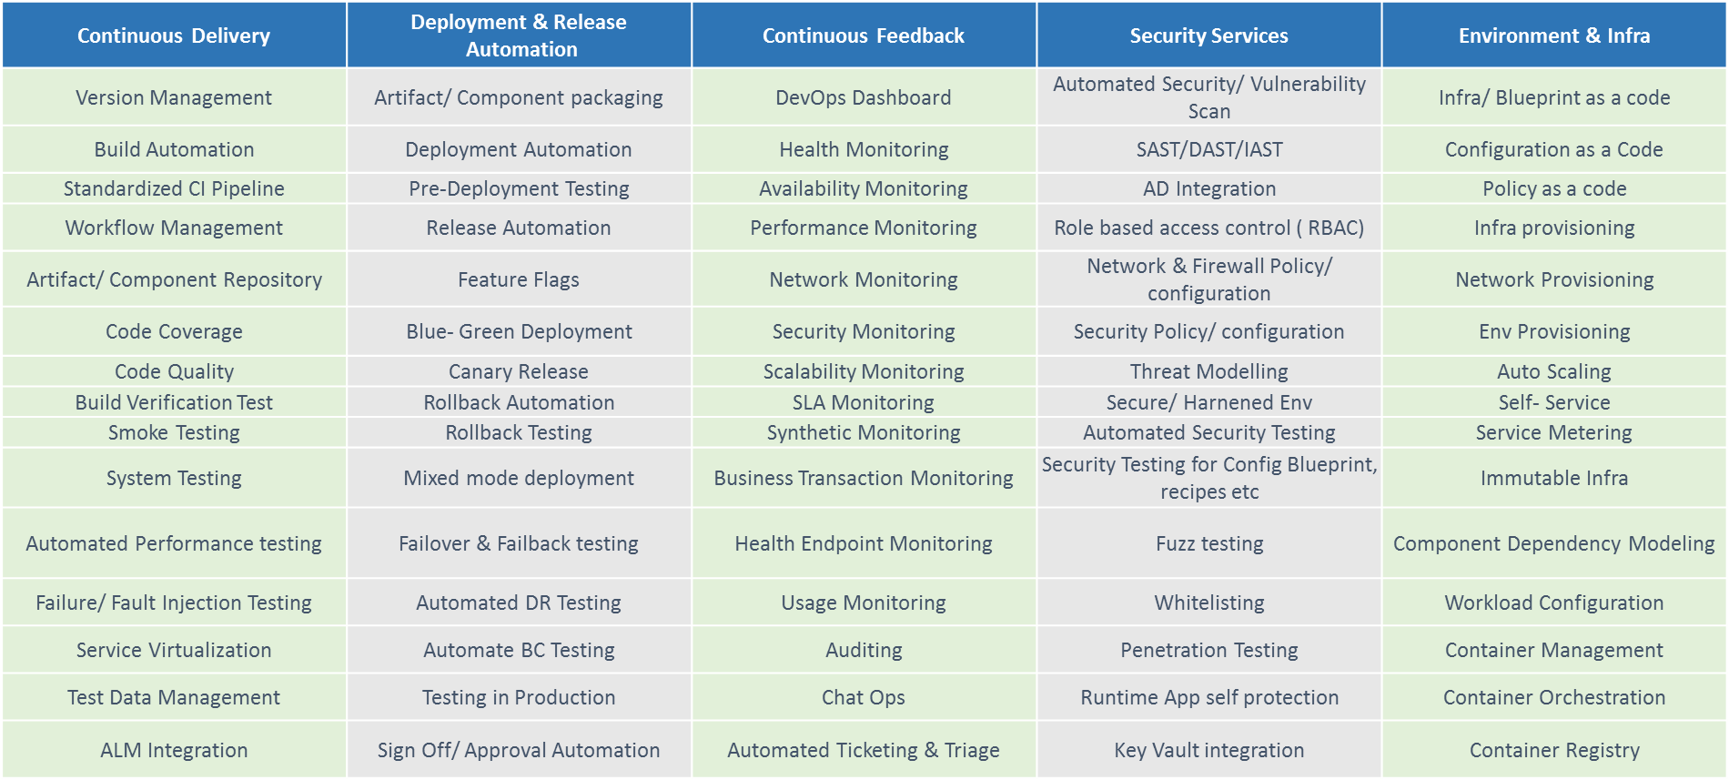
K-C DevOps Platform as Transformation Enabler
Building Enterprise DevOps Platform with Services offering for Different Technologies

Slide 28
Solution Consideration

Slide 29
We should choose pilot projects carefully… we propose following filter criteria
Why it matters? | … Ensures quick win … ensures realistic recommendations only … Leads to a execution plan, and strategy roadmap
1
Project portfolio | Apply filter criteria | Pilot project list
2
3
4
Wave 1: 2-5 Pilot project
Wave 2: 10-15 projects
Wave 3: more app areas
Wave 4: Enterprise roll out
Volume
Application Interfaces
Org Interfaces
Process
Tools
Velocity
How big is the project? Effort? Developer? Time?
How fast shippable code being developed? Agile?
How many external applications does the project interface with?
How many teams are involved in the project?
Is the project amenable to a different IT process?
Can we try out new tools for this project, if needed?
SAP-ERP or .Net portfolio
Ideal characteristics are:
Project < 10 developers Duration < 3 month Agile, or iterative waterfall with small iterations | Few external interfaces Willing to change process Sponsor has sufficient political clout

Slide 30


A day in a Life of Agile teams using K-C DevOps Platform
Phases
Requirement
Agile Planning
SCM and Development
Continuous Integration
Release and Deploy
Testing
Infrastructure
User Feedback
7. Source Code Management
12. Integration Builds , Packaging
14. Dev Deployment
3. Create Test cases
14. Dev Environment Creation
1.Create Import Requirements
2. Create User Stories
16. SIT Environment Creation
SAP
4. Release and Sprint Planning
8. Design and Development
13. Build Failure based on rule sets
17. SIT
.Net, MDM, Analytics
15. Deployment Failed
19. UAT Environment Creation
5. Task Assignment
9. Code Review Controls via tools
18. Test case execution Failed - Defect
Web
21. Prod Environment Creation
6. Release Management
16. SIT
Deployment
20. UAT
10. Unit Testing
Measure Code Coverage Metrics
19. UAT
Deployment
22. Environment Monitoring
11. Personal Builds , custom packaging
21. Prod Deployment
4. Capacity Planning
23. Incident
Sample
Tools
K-C DevOps Platform (Refer Platform services slide for details on Platform)
RDNG
RTC / UCR
Jira
WCSD, RAD, Sonar
RTC, SVN, Jenkins
BIF, UCR, UCD , Fastlane,
RQM, RFT,
RPT, RIT
UCDP, Chef, Cloud, New Relic
SNOW
Legend
Business Analyst
Product Owner
SCRUM Master
Development Team
Testing Team
Release & Deployment Team
Environment Team

Slide 31


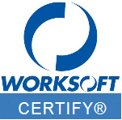

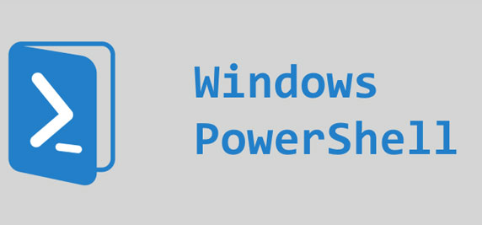


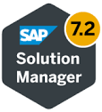





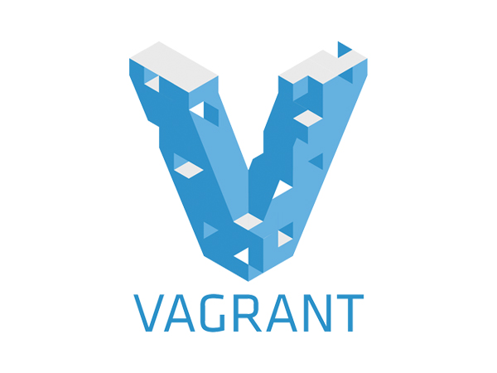
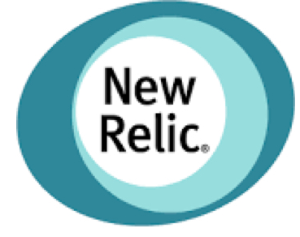
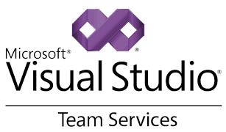










Indicative Tool stack
PLAN
CODE
BUILD
DEPLOY
TEST EXECUTION
Monitoring, Analytics &Feedback
SAP Transport
Management
SAP
Current Tool Stack
Non SAP
Indicative tool set.
(Further due diligence required)
Delivery Unit

Slide 32
Security as a Service - How is Enterprise Security Addressed?
Plan & Design
Code & Unit Test
Test
Deploy
Monitor
Security Functions
Secure Coding training
Secure Code reviews (IDE Plugins)
Static code analysis.
3rdParty Software vulnerability detections.
Data Masking / Anonymization
Automated Penetration Testing*
Automated Security Dynamic Testing*
Certificate & Key provisioning
Container security
Network scans
3rdParty S/W vulnerability
Network scans
Security Patch
Monitoring
Malware &Virus scan
CI / CD
Enterprise Release Management
Smart Environments
Feedback Amplification
Next - Gen DevOps
Security as Part of Single, Integrated, Continuous DevOps Process
Security APIs | Security as Code | Continuous Security Testing | Network Security Scans | Continuous Monitoring
Application / Source code level security is not compromised with DevOps.
It is strengthened through tighter, integrated, and automated process.

Slide 33
Security as a Service - DevSecOps
DevOps -> Efficiencies in speeding up the Lifecycle
DevSecOps -> Validating the Building Blocks
Security OF the CI/CD Pipeline
Access to the tools are controlled through proper validated users, groups, etc.
Accesses to execution / approval of a Release is provided to the approved users / groups to trigger / approve the next stage / phase
Access to the Jenkins or any other CI server for job execution is controlled
Access to the Code configuration tool for merging and branching is controlled
Access to infra provisioning / creation is limited to designated admin teams
Templates / blueprints of existing infra to help setup new environment / infra
Security IN the CI/CD Pipeline
Approvals for the next phases are built on automated rules
Sonar Rules for Code Quality are failed automatically if the gate criteria fails
Code vulnerability tests are performed on the static code to ensure no new vulnerabilities are introduced for every new code built in
Performance and stress Test Scenario are built to execute for the code deployed on an environment
Developed code has unit testing performed for every code to ensure sanity of the new code not breaking existing functionality
Infrastructure security validation to ensure the software and hardware meets the Enterprise Security standards.

Slide 34
Typical List of Real Time DevOps Analytics Metrics
CATEGORY
TECHNICAL INSIGHTS
BUSINESS INSIGHTS
People
Resource Identification
Defect Fixture
Time for Fixture
Build Commit Identification
Build Integrate Identification
Cost to reduce Technical Debt
Engineering
Slow Portfolios
Slow Applications
High Release Cost Applications
Portfolio Metrics
Application Metrics
Engineering ROI
Portfolio
Velocity
Velocity Trend
Release Value
Critical Areas
Green Areas
Release Cost
Pipeline
Bottleneck Identification
High Friction Zones
Pipeline Broken Area
Build Count
Time & Effort
Release Metrics
Application
Application Robustness
Technical Debt (TD)
Cost to reduce Technical Debt
Time to Market
Time To Market Trend
Application Biz Value
Legend
Quality Indices
Time To Market Indices
ROI / Cost Indices

Slide 35
About Assessment and Background

Slide 36
K-C DevOps Assessment engagement context
Engaged to
Benchmark the projects and Enhancements at K-C via Cognizant’s OneDevOps Maturity Assessment Framework
Analyze as-is processes, tollgates, workflows, tools and processes at K-C used during SDLC
Identify gaps, translate into epics for implementation
Recommend RoIe-based implementation roadmap
Recommend a target operating model for DevOps
Recommend a governance model for DevOps
Scope of engagement
Engineering/Process maturity of Application Development organizations for adopting DevOps Foundational functions.
Continuous integration/delivery/planning readiness
Feedback amplification via DevOps analytics

Slide 37
Initial problem statement and our approach
Problem statement | How to get started on DevOps Adoption journey with goal to Increase efficiency across SDLC. Facilitate faster releases and delivery cycle
We used following approach
Interviews | » | We interviewed stakeholders from various roles identified under the scope of this assessment. The stakeholders comprise of leaders, architects and SMEs from: Projects, Enhancements, Support Engineers, Application Development Team, Solution Architects & Business Analysts
Review of Automation Tools in used | » | We reviewed the existing as-is tools, technology and automation practices. Including build/deployment automation, test automation, tools integration(if any), SCM systems in place.
Analyzed the process with reference to DevOps standards | » | We analyzed end to end processes and workflows for Projects and enhancements, process workflows related to project planning, release planning, application development, test preparation, deployments and test data. We also covered organizational relationships between different roles, RACI between roles, handoffs and other facets of the organization.
Recommended solutions with DevOps best practices | » | Identified list of factors causing the symptoms. Created recommended epics. Provided a self-scoring Cognizant OneDevOps Maturity Continuum Framework to K-C for continued use

Slide 38
Following Portfolios and Capabilities we Reviewed during Assessment

Slide 39
We spoke with following team members during this assessment
K- C Team Members
1 | Martin Agliani | 11 | Rachel Sprehe | 21 | Dan Povolny | 31 | Walter Ochipinti | 41 | Matthew David
2 | Ariel Singer | 12 | Juan Figueiredo | 22 | Erik Barnes | 32 | Rich Meinke | 42 | Grace Hussein
3 | Jonathan Fleming | 13 | Sabrina Walker | 23 | Christian Dominguez | 33 | Shane Smith | 43 | Ramon Zamoranos
4 | Dave Beverlin | 14 | Alex Yang | 24 | Jason Olson | 34 | Justin Gengo | 44 | Meghan Tate
5 | Eric Thompson | 15 | Onn Wong | 25 | Hernan Conderanne | 35 | Trey Robinson | 45 | Juan Figueiredo
6 | Scott Wilson | 16 | Kevin Rosconi | 26 | Ezequiel Kogut | 36 | Ryan Steeno | 46 | Mario Sarmiento
7 | Cesar Garcia Jimenez | 17 | Claudia Arbanesi | 27 | Chris Haigh | 37 | Jay Butzler
8 | Robin Krisher | 18 | Federico Galban | 28 | Matthew Ocasek | 38 | Alfonso del Barrio Carcar
9 | Megan Meyer | 19 | Michael Price | 29 | Jerome de las Alas | 39 | Jonathan Boulos
10 | Janelle Zoeller | 20 | Ezequiel Carrascosa | 30 | Jonathan Medina | 40 | Renee Pearson
Cognizant Team Members
1 | Sana Auti | 4 | Nitin Vij | 7 | Shenal Jadhav | 10 | Deepak Dadhich | 13 | Carolina Carretto
2 | Sridhar Revu | 5 | Victor Laha | 8 | Sudheep Surendran | 11 | Manali Agrwal | 14 | Chandrasekaran B.
3 | Chaitanya | 6 | Sauren Nayak | 9 | Piyush Atre | 12 | Abbas Bagichawala | 15 | Rajiv Jayaraman

Slide 40
Assessment Findings

Slide 41
Consolidated view of key observations impacting Agility at K-C
Environment
Measurement
Testing
Test Data not available for Developers
Monitoring not standardized across K-C, teams decide on what and how to monitor
No Automated Test program in place
Standardized data masking process not in place
No failure notification process in place
Test process varies between portfolios, (who tests, when, etc.)
Lack of Agility and Inability to increase velocity
No automated code review
No data captured for metrics
No repeatable/reusable test scripts
Environment decommissioning process not in place
Build process is manual
Release Management Process not standardized across portfolios (Agile vs Waterfall)
Deployment process is manual
Release Management tool needs to be standardized (ServiceNOW vs Clarity)
Fixed deployment widow
No auto roll back capability
No centralized Release Management view is available.
Build/Deployment
Release Management

Slide 42
Typical Workflow at K-C and Representative Times for Projects
Elapsed Time | Actual Time Spent by Collective Team members (Hours)
4 Days | 10 Hours
12 Days | 24 Hours
8 Days | 18 Hours
4 Days | 8 Hours
60 Days | 180 Hours
48 Days | 120 Hours
10 Days | 24 Hours
Kickoff
Requirement Consolidation
Observations
Waterfall model is followed in most of the applications. Digital Production only is close to Agile model.
Productivity per project is less than 3 hours a day.
A balanced approach to design, development and code is needed to reduce the possible defects
Parallelism could be achieved for development, test risk assessment, test planning etc.
Technical Solution Def
Design Review
Design
Functional Spec Creation
Test Risk Assessment
Unit Testing
Development
Functional Accept Test
Testing
Test plan execution
Release Prep. &Deployment

Slide 43
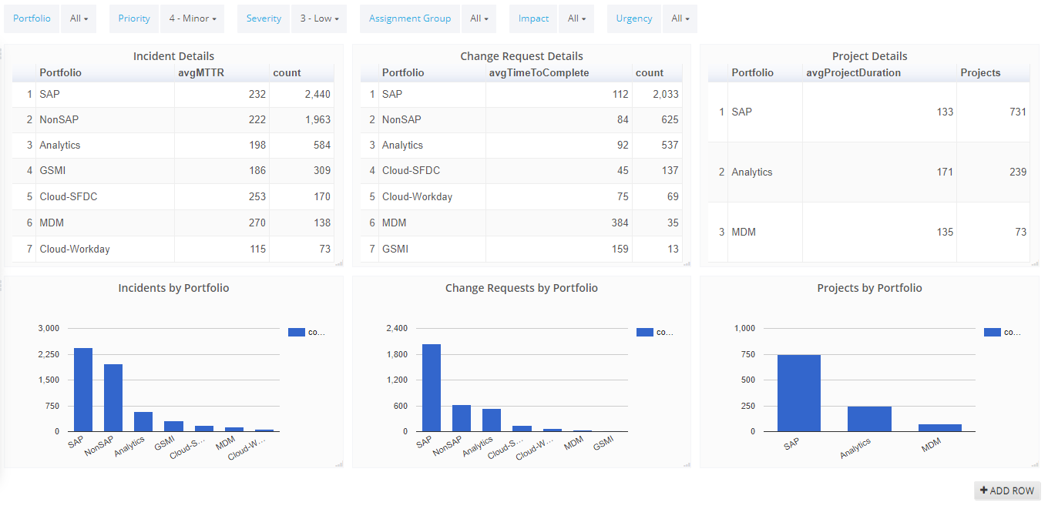
ServiceNow and Clarity observations (OneDevOps® InSights®)
Technology/Product details are not captured to classify Non-SAP. Actual efforts for incidents are not captured.
Technology/Product/CI details are not captured to classify Non-SAP. Avg. time spent on CRs is of the same order as Incidents
There are project marked Active with dates from 2014, impacting stats. Data is not available for phases of SDLC.

Slide 44
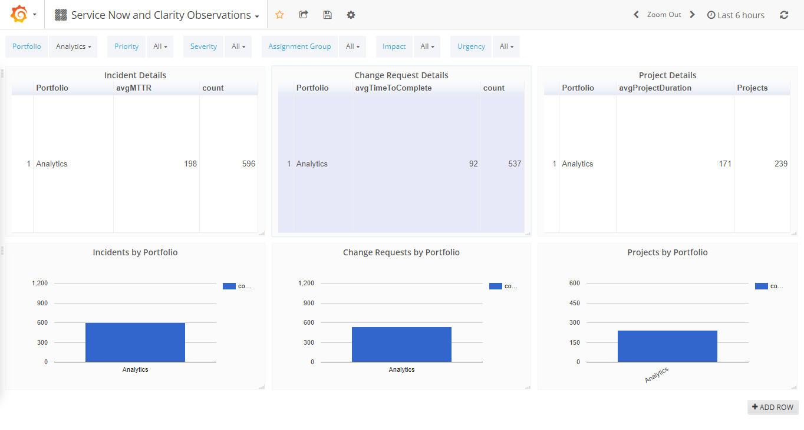
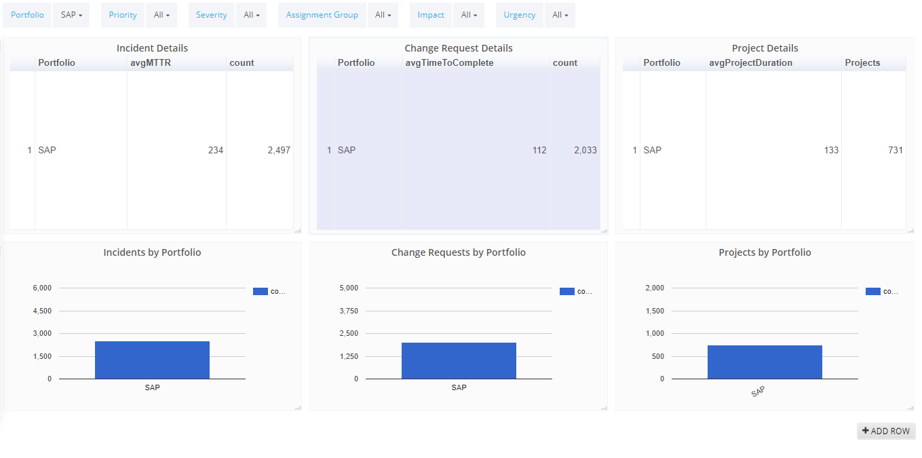
Drill-down sample (OneDevOps InSights®)

Slide 45
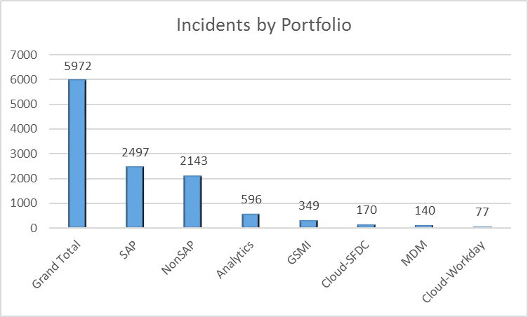
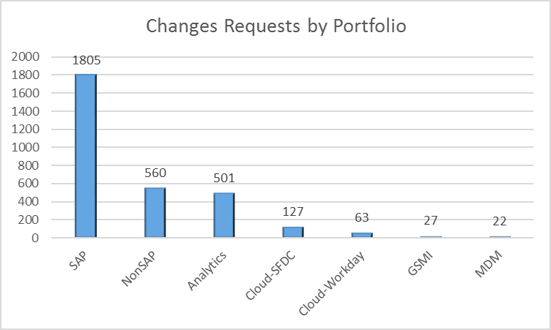
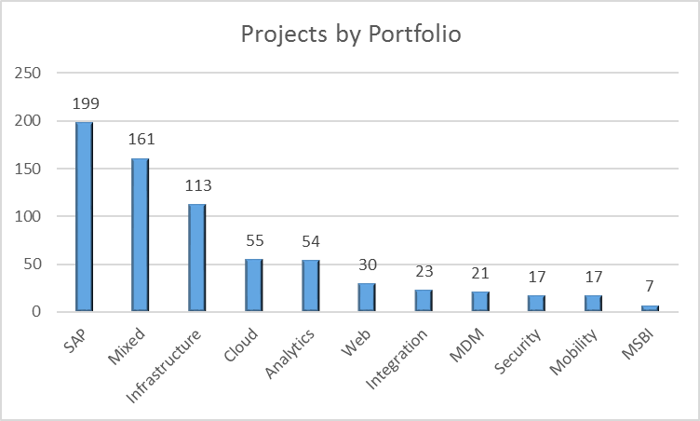
ServiceNow and Clarity observations
Incidents
Change Requests
Projects
Portfolio | Incidents | Avg. MTTR (in Hours)
SAP | 2497 | 228
NonSAP | 2143 | 234
Analytics | 596 | 229
GSMI | 349 | 198
Cloud-SFDC | 170 | 219
MDM | 140 | 266
Cloud-Workday | 77 | 111
Portfolio | Changes Requests | Avg. time to complete (in Hours)
SAP | 1805 | 98
NonSAP | 560 | 165
Analytics | 501 | 230
Cloud-SFDC | 127 | 300
Cloud-Workday | 63 | 193
GSMI | 27 | 164
MDM | 22 | 242
Portfolios | No. of Projects | Avg. Duration in Days
SAP | 199 | 120
Mixed | 161 | 148
Infrastructure | 113 | 141
Cloud | 55 | 100
Analytics | 54 | 161
Web | 30 | 116
Integration | 23 | 234
MDM | 21 | 138
Security | 17 | 148
Mobility | 17 | 90
MSBI | 7 | 202
Technology/Product details are not captured to classify Non-SAP. Actual efforts for incidents are not captured.
Technology/Product/CI details are not captured to classify Non-SAP. Avg. time spent on CRs is of the same order as Incidents
There are project marked Active with dates from 2014, impacting stats. Data is not available for phases of SDLC.
Incidents and Change Requests : Completed between May 2017 and Oct 2017
Projects : Active and Complete between May 2017 and Oct 2017

Slide 46
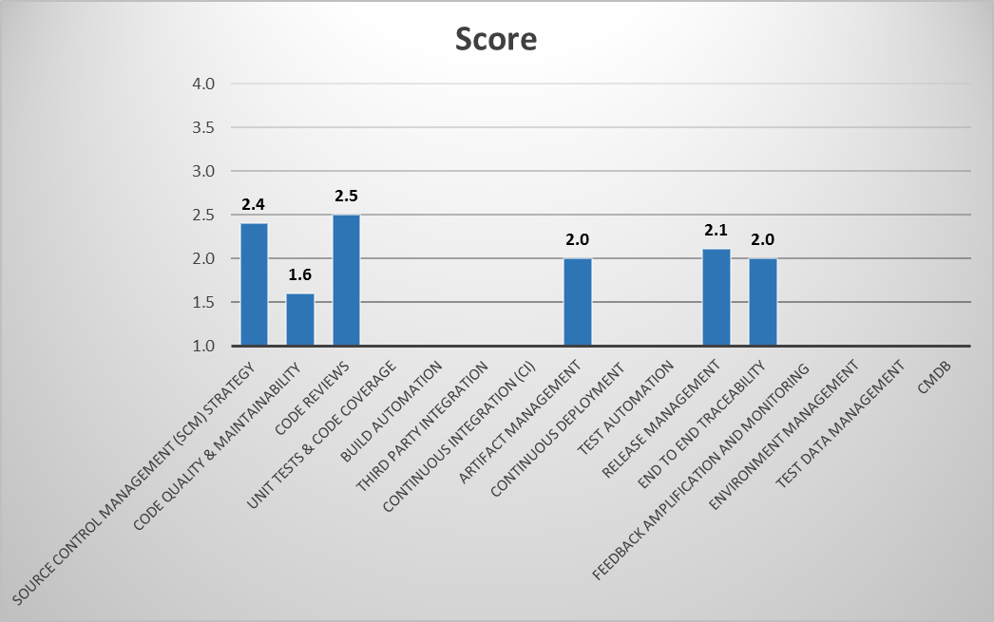
DevOps Maturity Scoring – SAP Portfolio
Ratings Based on Maturity Scale of 1 - 5

Slide 47
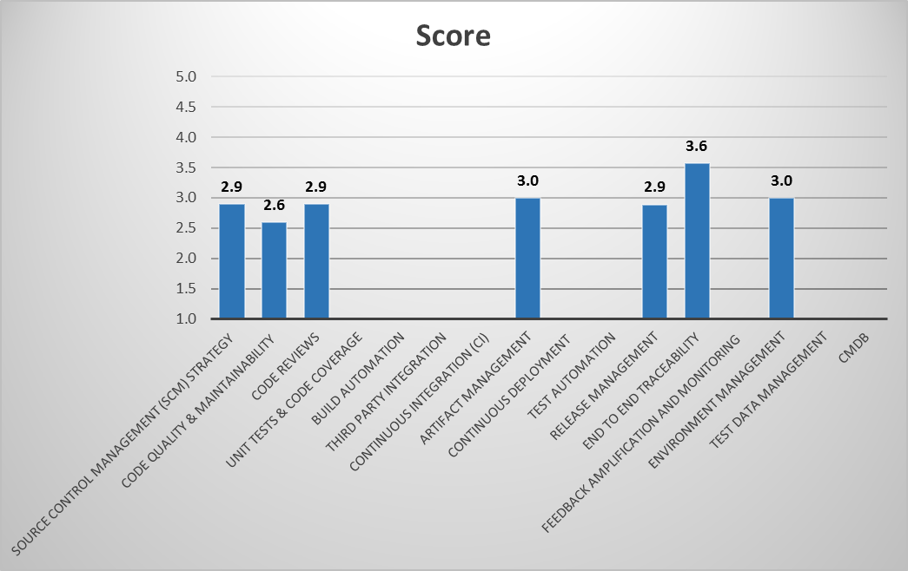
DevOps Maturity Scoring – Web/Digital Portfolios
Ratings Based on Maturity Scale of 1 - 5

Slide 48
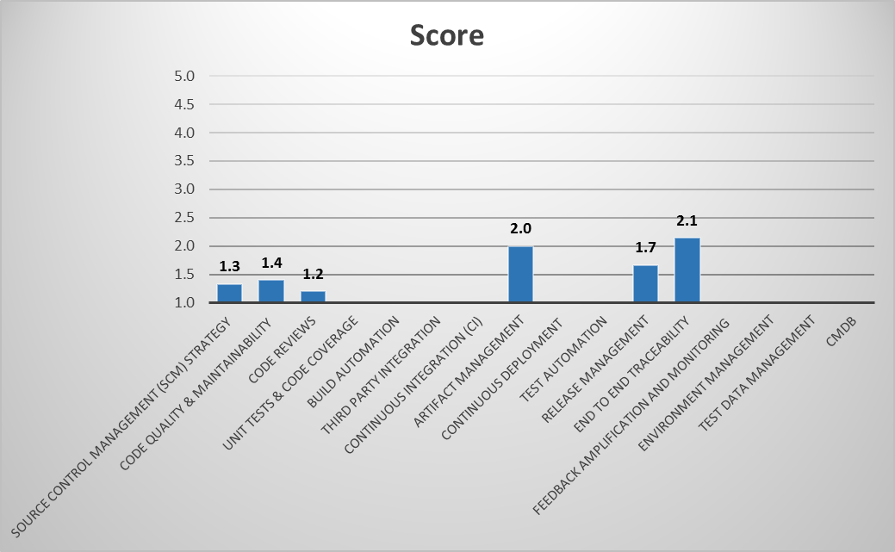
DevOps Maturity Scoring – Cloud
Ratings Based on Maturity Scale of 1 - 5

Slide 49
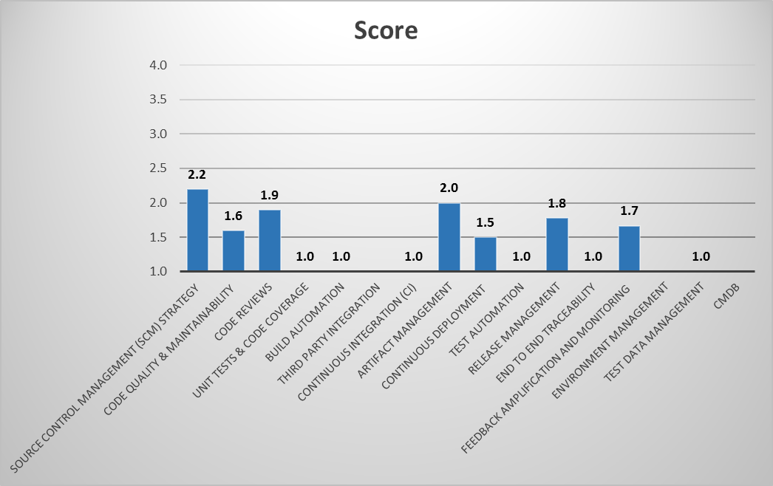
DevOps Maturity Scoring – Analytics
Ratings Based on Maturity Scale of 1 - 5

Slide 50
Observations in regards to Agile methodology practiced
Portfolios | SAP | Web - Digital Production | Mobility –IoT | Analytics | MDM | Cloud-SFDC | Cloud- Workday
Backlog Grooming | Twice a week | Weekly | Weekly | Weekly review of request list | Weekly review of request list | Every two weeks | Every two weeks
Iteration Planning | 2 weeks sprint | 3 weeks sprint | 3 weeks sprint | No | No | One month cycle | One month cycle
Daily Standup | Twice a week | Yes | Yes | No | No | No | No
Frequent deployments | Every Thursday | Yes | Yes | No | No | Every Thursday | As per need
Demos/Showcase | No | Yes | Yes | No | No | No | No
Retrospective | No | Yes | Yes | No | No | No | No
Agile Roles | Not all roles defined | Agile Roles Defined | Agile Roles Defined | Not all roles defined | Not all roles defined | Not all roles defined | Not all roles defined

Slide 51
About DevOps

Slide 52
DevOps as a Catalyst for K-C “Digital First Vision”
Application
DevOps (System Engineering)
Infrastructure
Transform to Agile as they embrace DevOps
Design and Architecture
Engineering
- Environment
- Enterprise CI/CD
- Enterprise Release Management
- DevOps Analytics
- Cloud
Transform
Assessment Focus

Slide 53
Flavors of Continuous * in an Enterprise DevOps context
Continuous Build
Code Done
Unit Tests
Integrate
Acceptance Test
Deploy to production
Auto
Manual
Manual
Manual
Continuous Integration
Code Done
Unit Tests
Integrate
Acceptance Test
Deploy to production
Auto
Auto
Manual
Manual
Continuous Delivery
Code Done
Unit Tests
Integrate
Acceptance Test
Deploy to production
Auto
Auto
Auto
Manual

Slide 54
Maturity Analysis

Slide 55
DevOps Maturity for App Dev and Enhancement
Vision
Facet | Level 1 | Level 2 | Level 3 | Level 4
Objectives | Defined ad-hoc, need based. | 90 days objectives defined. 50% aligned with Organization roadmap | 180 days objectives defined 80% aligned with Organization roadmap | 365 days objectives defined Organization roadmap is created with DevOps objectives
Metrics | No vision or strategy for metrics collection | Metrics collection strategy is defined for 50% of the portfolios. | Metrics collection strategy is defined for 80% of the portfolios. | Metrics collection strategy defined for all the portfolios.
Financial Model | No budget. Ad-hoc assignment of budget for DevOps | Respective functions include budgets for implementing specific DevOps solution themes | Fixed quota based DevOps budgets for specific product bundles | Enterprise DevOps budget is well defined for 100% of the applications
Operating Model | Current Model is Ad-hoc. No defined Target Operating Model (TOM). | TOM Defined partially for certain areas of IT | Defined and Operating on TOM for all 50% areas of IT | Already operating with 100% adherence to TOM

Slide 56
DevOps Maturity for App Dev and Enhancement
Strategy
Facet | Level 1 | Level 2 | Level 3 | Level 4
Continuous Planning | Forecasting and dependencies are reviewed on ad-hoc basis. Demand & capacity planning done on ad-hoc basis. | Forecasting and dependency reviews happen at a cadence but in silos. Demand & capacity planning happens at a cadence but in silos. | Forecasting and dependencies reviews happen at a cadence and integrated at IT level. Demand & capacity planning happens at a cadence and integrated at IT level. | Forecasting and dependencies reviews happens at a cadence and integrated at IT and Business level. Demand & capacity planning happens at a cadence and integrated at IT and Business level.
Continuous Delivery | No DevOps services creation and consumption strategy defined | DevOps services creation and consumption strategy defined in silos. | DevOps services creation and consumption strategy defined at IT level. | DevOps services creation and consumption strategy defined at organization level.
Continuous Releases | Informal release planning. Mostly ad-hoc. | Formal Release Planning followed. Velocity based planning. | Advanced enterprise release trains employed. But still not release on demand | Release on demand for 100% of the portfolios. Cost can be associated for a release.
Continuous Feedback | No cohesive strategy in place for business, process, applications and infrastructure monitoring & feedback | Monitoring and feedback strategy in place for applications and infrastructure Business and processes are not considered part of same strategy. | Monitoring and feedback strategy in place applications and infrastructure Business and processes are somewhat considered part of same strategy. | Cohesive strategy in place for business, process, applications and infrastructure monitoring & feedback

Slide 57
DevOps Maturity for App Dev and Enhancement
Capability
Facet | Level 1 | Level 2 | Level 3 | Level 4
Tools | Plethora of tools but not rationalized | Tools rationalized in select LOBs and functions | Standardized set of tool used across enterprise | E2E tool chain integration and orchestration across CI/CD functions
Skills and Competency | Application development is siloes based on app functionality . No defined structure. | Application development is standardized. But hygiene issue exists. | High performance teams. Agile engineering practices strictly enforced | Cross functional teams. Full stack programmers with best in class practices.
Architecture | No defined DevOps architecture structure/operation design or process in place | Defined DevOps architecture structure/operation design in place. Tollgates not in place for enforcement | Defined DevOps architecture structure/operation design in place. Tollgates are in place for enforcement No change management defined for architecture updates | Defined DevOps architecture structure/operation design in place. Tollgates are in place for enforcement Change management process defined for architecture updates
Measurement | Capability does not exist for measurements and continuous feedback | Capability exists for measurements and continuous feedback in 50% of the portfolios | Capability exists for measurements and continuous feedback in 80% of the portfolios | Capability exists for measurements and continuous feedback in all of the portfolios

Slide 58
DevOps Maturity for App Dev and Enhancement
Execution
Facet | Level 1 | Level 2 | Level 3 | Level 4
Implementation Roadmap & Plans | No DevOps roadmap or implementation plan in place or very generic with no timeline | Specific Roadmap or implementation plan in place for 50% of enhancements/projects | Specific Roadmap or implementation plan in place for 80% of enhancements/projects | Specific Roadmap or implementation plan in place for all enhancements/projects
Roles Definition | Roles not defined for the DevOps way of working | Roles defined for the DevOps way of working for 50% of the applications/portfolios | Roles defined for the DevOps way of working for 80% of the applications/portfolios | Roles defined for the DevOps way of working for all of the applications/portfolios
Portfolio Team Alignment | Teams are shared. No integration between Application Development, Enhancement and DevOps Engineering teams. | Separate teams for Application Development, Enhancement and DevOps Engineering. | Dedicated pods with Application Development, Enhancement and DevOps Engineering capabilities, but not followed in all applications/portfolios. | Dedicated pods with Application Development, Enhancement and DevOps Engineering capabilities.
IT Tracking & Control | Informal procedures to track progress in application delivery | Typical PMI type tracking and control of application delivery | Agile and Scrum based tracking in terms of epics and stories | Qualitative tracking and control of application delivery via DevOps KPIs and Metrics

Slide 59
Detailed solution for SAP, .Net and DevSecOps

Slide 60
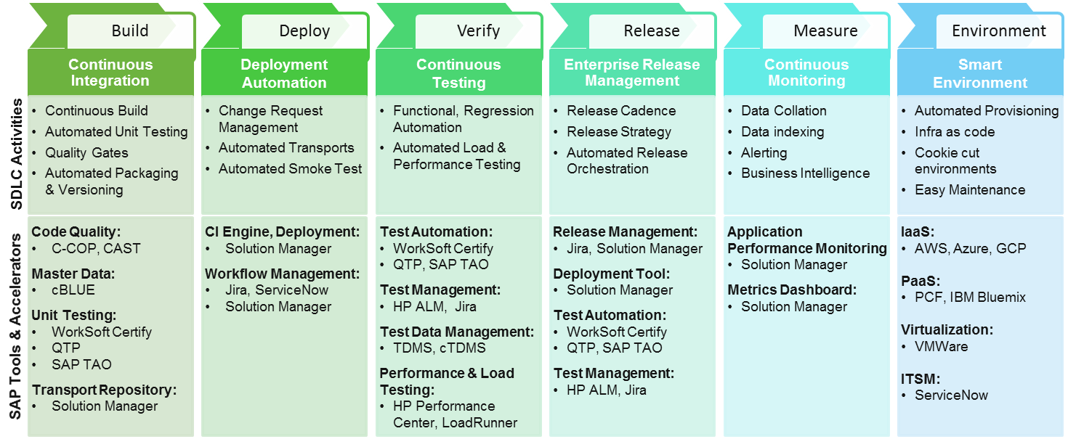

DevOps for SAP – SDLC Framework - Our Recommendation
SDLC Activities
Recommended SAP Tools and Accelerators
Automation
Enablers
→ Tools K-C has

Slide 61
Reference Architecture across DevOps vectors for
On Premise SAP Applications (ECC, SCM, SRM, CRM, S/4 HANA)

Slide 62
DevOps Reference Architecture across DevOps Vectors
Build
Deploy
Verify
Release
Measure
Environment
DEVOPS BUILDING BLOCKS TO ENABLE AUTOMATION ACROSS THE DEVOPS VECTORS
Design and Configure
Develop
Unit Test
Transport
Trigger Deployment
Deploy Transport
Sanity Test
Notify
Test Initiation
Functional & Regression Testing
NFR Testing
Verification Approval
Test Closure
Planning
Definition
Workflow & Approvals
Rollout
Closure
Define KPI’s
Implement
Collect & Collate
Measure & Evolve
Planning
Procurement
Provisioning
Maintenance
Teardown
Implementation Details
Continuous Integration
Continuous Build
Automated Unit Testing
Deployment Automation
Automated Artifact Movement
Automated Deployment
Continuous Testing
Functional & Regression Automation
Automated Load & Performance Testing
Enterprise Release Management
Continuous Monitoring
Smart Environment
Automated Packaging & Versioning
Automated Smoke Test
Automated Release Orchestration
Data Collation
Data indexing
Alerting
Release Cadence
Release Strategy
Quality Gates
Business Intelligence
Automated Provisioning
Infra as code
Cookie cut environments
Easy Maintenance
Functions

Slide 63
Reference Architecture – Build Vector for SAP
Design & Configure
Develop
Unit Test
Transport
Functions | Implementation Details | Automation Considerations | Tools Recommendation
Code Review:
C-COP
Master Data:
cBLUE
Unit Testing:
WorkSoft Certify
QTP
SAP TAO
Transport Repository:
Solution Manager
Design & Configure
Define “To-Be” processes
Finalize RICEFW
Prepare FS, TS
Configure
Code Review
Develop
Develop RICEFW
Code Review
Create Master Data
Develop Test Cases
Set up QA Env
Create Master Data
Setup QA Env
Unit Test
Run unit Test
Publish Result
Run Unit Test
Publish Result
Transport
Transport Sequence
Move Transports
Move Transports

Slide 64
Reference Architecture – Deploy Vector for SAP
Trigger Deployment
Sanity Test
Deploy Transport
Notify
Functions | Implementation Tasks | Automation Considerations | Tool Recommendation
Deployment Workflow
CI Engine:
Solution Manager
Workflow Management Tool:
Jira
ServiceNow
Solution Manager
Deployment Tool:
Solution Manager
Test Automation:
WorkSoft Certify
QTP
SAP TAO
Test Management:
HP ALM
Jira
Trigger Deployment
Deployment Req
Deployment workflow
Deployment Request
Invoke Deployment
Deployment Request
Invoke Deployment
Validate Transport Sequence
Move Transports
Deploy Transport
Move Transport
Sanity Test
Run Sanity Test
Update Sanity Test Results
Run Sanity Test
Update Sanity Test Results
Update Deployment Status
Rollback Deployment on failure
Publish Release Notes
Update Deployment Status
Notify
Rollback Deployment on failure
Publish Release Notes

Slide 65
Reference Architecture – Verify Vector for SAP
Test Initiation
Functional & Regression Testing
Release Approval
NFR Testing
Test Closure
Functions | Implementation Tasks | Automation Considerations | Tool Recommendation
Test Initiation
Deploy Artifact to Env
Sanity Test - Pass
Create Test Cycle
Deploy Artifact to Env
Release Management:
Jira
Solution Manager
Test Automation:
WorkSoft Certify
QTP
SAP TAO
Test Management:
HP ALM
Jira
Test Data Management:
TDMS
cTDMS
Performance & Load Testing:
HP Performance Center
LoadRunner
Sanity Test
Functional & Regression Testing
Run Functional Test
Record Functional Test Results
Run Regression Test
Record Regression Test Results
Functional Test Automation
Regression Test Automation
NFR Testing
Run Load/ Performance Test
Record Load/ Performance Test Results
Load/ Performance Test Automation
Verification Approval
Approve Release based on Test Results
Approve Release based on Test Results
Test Closure
Perform Smoke Test
Archive Test Results
Perform Production Smoke Test

Slide 66
Reference Architecture – Release Vector for SAP
Planning
Definition
Rollout
Workflow & Approval
Closure
Functions | Implementation Tasks | Automation Considerations | Tool Recommendation
Planning
Establish Release Cadence
Release Management:
Jira
Solution Manager
Deployment Tool:
Solution Manager
Test Automation:
WorkSoft Certify
QTP
SAP TAO
Test Management:
HP ALM
Jira
Definition
Define Release Scope
Track Release Dependency
Map work items to release
Workflow & Approvals
Release Request
Release Approval
Release to next env
Release Dependency Management
Release Approval
Release to next env
Rollout
Prod Rollout Request
Prod Rollout Approval
Rollout Release
Prod Rollout Approval
Rollout Release
Closure
Publish Release Notes
Archive release work items

Slide 67
Reference Architecture – Measure Vector for SAP
Define KPI’s
Implement
Measure
Collect & Collate
Functions | Implementation Tasks | Automation Considerations | Tool Recommendation
Application Performance Monitoring
Solution Manager
Define KPI’s
Define the KPI’s to be measured
Design Considerations
Implement
Implement Monitoring
Develop SOP’s
Test
Collect data
Index data
Collate data
Create visualization
Collect & Collate
Measure
OCC Dashboard
Alerting
Create Ticket
OCC Dashboard
Alerting
Create Ticket

Slide 68
Reference Architecture – Environment Vector for SAP
Environment =
Bare Metal + OS + Middleware + DB/Data Store
Plan
Procure
Provision
Maintain
Teardown
Functions | Implementation Tasks | Automation Considerations
Plan
Hardware & Software Requirement Definition
Environment Definition
Capacity Planning
IaaS:
AWS
Azure
PaaS:
PCF
IBM Blumix
Virtualization:
VMWare
OS:
Linux (Ubuntu)
Windows
Monitoring:
Solution Manager
ITSM:
ServiceNow
Purchase Hardware, Storage, Data Store
Purchase Software & other utilities
Allocate Rack Space
Purchase Hardware, Storage
Procure
Purchase Software & other utilities
Allocate Rack Space
Hardware/Network/Storage Setup
Provision
Hardware/Network/Storage Setup
Install Software
Setup Access Controls
Provision Environments
Install Software
Setup Access Controls
Provision Environments
Environment Patching
Maintain
Environment Patching
Environment Booking & Scheduling
Environment Monitoring & Maintenance
Environment Booking & Scheduling
Environment Monitoring & Maintenance
Teardown
Decommission Environment
Uninstall Software
Decommission Hardware
Decommission Environment

Slide 69
Reference Architecture across DevOps Vectors for
BI/BO/BODS/HANA

Slide 70
DevOps Reference Architecture across DevOps Vectors
DEVOPS BUILDING BLOCKS TO ENABLE AUTOMATION ACROSS THE DEVOPS VECTORS
Build
Deploy
Verify
Release
Measure
Environment
Design and Configure
Develop
Unit Test
Transport/Code Promotion/MTP
Trigger Deployment
Deploy Transport / Job Promotion
Sanity Test
Notify
Test Initiation
Functional & Regression Testing
NFR Testing
Verification Approval
Test Closure
Planning
Definition
Workflow & Approvals
Rollout
Closure
Define KPI’s
Implement
Collect & Collate
Measure & Evolve
Planning
Procurement
Provisioning
Maintenance
Teardown
Implementation Details
Continuous Integration
Continuous Build
Automated Unit Testing
Deployment Automation
Automated Artifact Movement
Automated Deployment
Continuous Testing
Functional & Regression Automation
Automated Load & Performance Testing
Enterprise Release Management
Continuous Monitoring
Smart Environment
Automated Packaging & Versioning
Automated Smoke Test
Automated Release Orchestration
Data Collation
Data indexing
Alerting
Release Cadence
Release Strategy
Quality Gates
Business Intelligence
Automated Provisioning
Infra as code
Cookie cut environments
Easy Maintenance
Functions

Slide 71
Reference Architecture – Build Vector for SAP
Design & Configure
Develop
Unit Test
Transport
Functions | Implementation Details | Automation Considerations | Tools Recommendation
Code Review:
BADI Tool
BI Comparator
ABAP CodeReviewer
Unit Testing:
QTP
Transport Repository:
Solution Manager
Design & Configure
Define “To-Be” Data Model
Finalize Data Model
Prepare FS, TS
Configure
Develop Data Model
Review Data Model/Code
Load / Create Data
Develop Test Cases
Set up QA Env
Code Review
Develop
Setup QA Env
Unit Test
Run unit Test
Publish Result
Run Unit Test
Publish Result
Transport
Transport / Code Promotion Sequence
Move Transports/Job Promotion
Move Transports / Job Promotion

Slide 72
Reference Architecture – Deploy Vector for SAP
Trigger Deployment
Sanity Test
Deploy Transport
Notify
Functions | Implementation Tasks | Automation Considerations | Tool Recommendation
Deployment Workflow
CI Engine:
Solution Manager
Workflow Management Tool:
Jira
ServiceNow
Solution Manager
Deployment Tool:
Solution Manager
Test Automation:
QTP
Test Management:
HP ALM
Jira
Trigger Deployment
Deployment Req
Deployment workflow
Deployment Request
Invoke Deployment
Deployment Request
Invoke Deployment
Validate Transport / Code Promotion Sequence
Move Transports / Job Promotion
Deploy Transport
Move Transport/Job Promotion
Sanity Test
Run Sanity Test
Update Sanity Test Results
Run Sanity Test
Update Sanity Test Results
Update Deployment Status
Rollback Deployment on failure
Publish Release Notes
Update Deployment Status
Notify
Rollback Deployment on failure
Publish Release Notes

Slide 73
Reference Architecture – Verify Vector for SAP
Test Initiation
Functional & Regression Testing
Release Approval
NFR Testing
Test Closure
Functions | Implementation Tasks | Automation Considerations | Tool Recommendation
Test Initiation
Deploy Artifact to Env
Sanity Test - Pass
Create Test Cycle
Deploy Artifact to Env
Release Management:
Jira
Solution Manager
Test Automation:
QTP
Test Management:
HP ALM
Jira
Performance & Load Testing:
HP Performance Center
LoadRunner
Sanity Test
Functional & Regression Testing
Run Functional Test
Record Functional Test Results
Run Regression Test
Record Regression Test Results
Functional Test Automation
Regression Test Automation
NFR Testing
Run Load/ Performance Test
Record Load/ Performance Test Results
Load/ Performance Test Automation
Verification Approval
Approve Release based on Test Results
Approve Release based on Test Results
Test Closure
Perform Smoke Test
Archive Test Results
Perform Production Smoke Test

Slide 74
Reference Architecture – Release Vector for SAP
Planning
Definition
Rollout
Workflow & Approval
Closure
Functions | Implementation Tasks | Automation Considerations | Tool Recommendation
Planning
Establish Release Cadence
Release Management:
Jira
Solution Manager
Deployment Tool:
Solution Manager
Test Automation:
QTP
Test Management:
HP ALM
Jira
Definition
Define Release Scope
Track Release Dependency
Map work items to release
Workflow & Approvals
Release Request
Release Approval
Release to next env
Release Dependency Management
Release Approval
Release to next env
Rollout
Prod Rollout Request
Prod Rollout Approval
Rollout Release
Prod Rollout Approval
Rollout Release
Closure
Publish Release Notes
Archive release work items

Slide 75
Reference Architecture – Measure Vector for SAP
Define KPI’s
Implement
Measure
Collect & Collate
Functions | Implementation Tasks | Automation Considerations | Tool Recommendation
Application Performance Monitoring
Solution Manager
Define KPI’s
Define the KPI’s to be measured
Design Considerations
Implement
Implement Monitoring
Develop SOP’s
Test
Collect data
Index data
Collate data
Create visualization
Collect & Collate
Measure
OCC Dashboard
Alerting
Create Ticket
OCC Dashboard
Alerting
Create Ticket

Slide 76
Reference Architecture – Environment Vector for SAP
Environment = Bare Metal + OS + Middleware + DB/Data Store
Plan
Procure
Provision
Maintain
Teardown
Functions | Implementation Tasks | Automation Considerations
Plan
Hardware & Software Requirement Definition
Environment Definition
Capacity Planning
IaaS:
AWS
Azure
PaaS:
PCF
IBM Blumix
Virtualization:
VMWare
OS:
Linux (Ubuntu)
Windows
Monitoring:
Solution Manager
ITSM:
ServiceNow
Purchase Hardware, Storage, Data Store
Purchase Software & other utilities
Allocate Rack Space
Purchase Hardware, Storage
Procure
Purchase Software & other utilities
Allocate Rack Space
Hardware/Network/Storage Setup
Provision
Hardware/Network/Storage Setup
Install Software
Setup Access Controls
Provision Environments
Install Software
Setup Access Controls
Provision Environments
Environment Patching
Maintain
Environment Patching
Environment Booking & Scheduling
Environment Monitoring & Maintenance
Environment Booking & Scheduling
Environment Monitoring & Maintenance
Teardown
Decommission Environment
Uninstall Software
Decommission Hardware
Decommission Environment

Slide 77
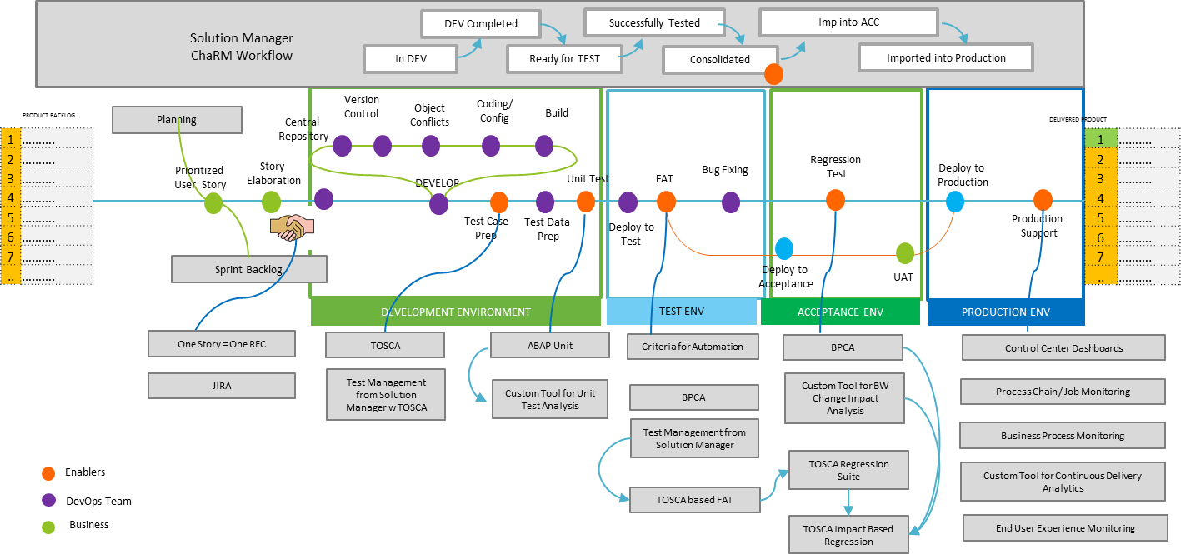
A Working Model for SAP DevOps

Slide 78
Reference Architecture across DevOps Vectors for
.Net (Microsoft Stack)

Slide 79
DevOps Reference Architecture across DevOps Vectors
Build
Deploy
Verify
Release
Measure
Environment
DEVOPS BUILDING BLOCKS TO ENABLE AUTOMATION ACROSS THE DEVOPS VECTORS
Code Storage
Compile
Unit Test
Store Artifact
Trigger Deployment
Fetch & Copy Artifact
Deploy Artifact
Sanity Test
Notify
Test Initiation
Functional & Regression Testing
NFR Testing
Verification Approval
Test Closure
Planning
Definition
Workflow & Approvals
Rollout
Closure
Define KPI’s
Implement
Collect & Collate
Measure & Evolve
Planning
Procurement
Provisioning
Maintenance
Teardown
Implementation Details
Continuous Integration
Continuous Build
Automated Unit Testing
Deployment Automation
Automated Artifact Movement
Automated Deployment
Continuous Testing
Functional & Regression Automation
Automated Load & Performance Testing
Enterprise Release Management
Continuous Monitoring
Smart Environment
Automated Packaging & Versioning
Automated Smoke Test
Automated Release Orchestration
Data Collation
Data indexing
Alerting
Release Cadence
Release Strategy
Quality Gates
Business Intelligence
Automated Provisioning
Infra as code
Cookie cut environments
Easy Maintenance
Functions

Slide 80
Reference Architecture – Build Vector for Microsoft Stack
Check out
Compile
Unit Test
Store Artifact
Functions | Implementation Details | Automation Considerations | Tools Recommendation
SCM:
GIT, TFVC,
Build Tool:
MSBuild,
Nant,
Gradle
Powershell
Static Analyzer:
SonarQube
CodeAnalysis from VSTS
Custom Code Analysers with Roslyn
FxCop
Unit Testing:
Nunit, IntelliTest, xUnit and MStest
Security Analysis
Microsoft Baseline Security Analyzer
Microsoft Security Assessment Tool (MSAT)
Veracode, Appscan
CodeDX
Artifact Repository:
Nuget
VSTS Package Manager
Nexus
Merge Changes
Check out Code
Create Branch
Check-in Changes
Merge Changes
Pull Latest Code
Check code Standards
Code Check-out
Enforce Code Standards
Setup Build Env
Compile Code
Setup compile Env
Pull Dependencies
Compile Code
Package Code & versioning
Pull Dependencies
Compile Code
Package Code
Run Unit Test
Unit Test
Run unit Test
Publish Result
Measure Coverage
Publish Coverage Result
Publish Result
Measure Coverage
Publish Coverage Result
Store Artifact
Upload artifact
Publish artifact
Upload Artifact
Publish Artifact

Slide 81
Reference Architecture – Deploy Vector for Microsoft Stack
Trigger Deployment
Fetch & Copy Artifact
Sanity Test
Deploy Artifact
Notify
Functions | Implementation Tasks | Automation Considerations | Tool Recommendation
Deployment Workflow
Workflow Mgmt. Tool:
Team Foundation Server, VSTS
Jira, ServiceNow
CI Engine:
Build definition using hosted build agent in VSTS and TFS
Custom task using PowerShell
Jenkins, Teamcity, bamboo
Deployment Tool:
VTSTS – Hosted and custom build agent OR TFS
OctopusDeploy
CruiseControl.NET
DB Deployment:
SQL Server Data Tools (SSDT)
Azure SQL Database Deployment – Deploy using DACPAC
Liquibase
DB Maestro
Trigger Deployment
Deployment Req portal or CI Engine
Deployment workflow
Deployment Request
Invoke Deployment
Deployment Request
Invoke Deployment
Fetch Artifact
Fetch Dependency
Copy Artifact to target
Copy Dependency to target
Fetch Artifact
Fetch & Copy Artifact(s)
Fetch Dependency
Copy Artifact to Target
Copy dependency to target
Setup App Environment
Update Config/ Metadata
Deploy Artifact
Setup App Environment
Deploy Artifact
Update Config/Metadata
Deploy Artifact
Sanity Test
Run Sanity Test
Update Sanity Test Results
Run Sanity Test
Update Sanity Test Results
Update Deployment Status
Rollback Deployment on failure
Publish Release Notes
Update Deployment Status
Notify
Rollback Deployment on failure
Publish Release Notes

Slide 82
Reference Architecture – Verify Vector for Microsoft Stack
Test Initiation
Functional & Regression Testing
Release Approval
NFR Testing
Test Closure
Functions | Implementation Tasks | Automation Considerations | Tool Recommendation
Test Initiation
Deploy Artifact to Env
Sanity Test - Pass
Create Test Cycle
Deploy Artifact to Env
Agile Life Cycle Support
VSTS, TFS, JIRA, Zephyr
Test Management:
Test hub in VSTS, Microsoft Test Manager, HP ALM, IBM RQM, TestRail, Tarantula
Traceability
Cross Platform support for Agile in VSTS
Eclipse and IntelliJ or cross-platform command-line tools
Service Virtualization:
CA DevTest, Parasoft Virtualize, HP Service Manager
Test Data Management:
TD Maxim
Data Virtualization:
Delphix, Actifio
Automated Testing
Coded UI, Selenium, VSTS Test Hub, HP UFT, IBM RFT, SahiPro, Telerik – Test Studio
Performance & Load Testing:
VSTS load Testing, HP Load Runner, IBM RPT, NeoLoad, Gatling, Grinder
Sanity Test
Functional Test Automation
Functional & Regression Testing
Run Functional Test
Record Functional Test Results
Run Regression Test
Record Regression Test Results
Correlate Functional Test Results
Regression Test Automation
Correlate Regression Test Results
Run Load/ Performance Test
Record Load/ Performance Test Results
Load/ Performance Test Automation
NFR Testing
Correlate Automated Load/ Performance Test Results
Verification Approval
Approve Release based on Test Results
Approve Release based on Test Results
Test Closure
Perform Smoke Test
Archive Test Results
Perform Production Smoke Test

Slide 83
Reference Architecture – Release Vector for Microsoft Stack
Planning
Definition
Rollout
Workflow & Approval
Closure
Functions | Implementation Tasks | Automation Considerations | Tool Recommendation
Planning
Establish Release Cadence
Release Management:
VSTS release management solution
OctopusDeploy
UrbanCode Deploy
CA Nolio
Powershell
Configuration Management:
Chef
Puppet
Ansible
DB Deployment:
SQL Server Data Tools (SSDT)
Liquibase
DB Maestro
Definition
Define Release Scope
Track Release Dependency
Map work items to release
Workflow & Approvals
Release Request
Release Approval
Release to next env
Release Dependency Management
Release Approval
Release to next env
Release Dependency Mgmt
Rollout
Prod Rollout Request
Prod Rollout Approval
Rollout Release
Prod Rollout Approval
Rollout Release
Closure
Publish Release Notes
Archive release work items

Slide 84
Reference Architecture – Measure Vector for Microsoft Stack
Define KPI’s
Implement
Measure
Collect & Collate
Functions | Implementation Tasks | Automation Considerations | Tool Recommendation
Log Management:
Log Analytics
Splunk
ELK
Infra Monitoring:
Nagios
Zabbix
Zenoss
Dynatrace
Application Performance Monitoring:
Application Insights
AppDynamics
New Relic
Communication:
Hipchat
ITSM:
ServiceNow
Jira Service Desk
Define KPI’s
Define the KPI’s to be measured
Design Considerations
Implement
Instrument Code for KPI
Inject monitoring agents into env
Forward data
Recipes for Agent Installation
Forward data
Collect data
Index data
Collate data
Create visualization
Collect Data
Collect & Collate
Index data
Collate data
Measure
Business Dashboard
Infra Dashboard
Alerting
Business Dashboard
Infra Dashboard
Alerting

Slide 85
Reference Architecture – Environment Vector For Microsoft Stack
Environment = Bare Metal + OS + Middleware + DB/Data Store
Plan
Procure
Provision
Maintain
Teardown
Functions | Implementation Tasks | Automation Considerations
Plan
Hardware & Software Requirement Definition
Environment Definition
Capacity Planning
IaaS:
Azure
AWS
PaaS:
PCF
IBM Blumix
Virtualization:
Hyper V
VMWare
OS:
Windows
CMP:
Scalr
Configuration Management:
Chef
Puppet
Ansible
ITSM:
ServiceNow
Purchase Hardware, Storage, Data Store
Purchase Software & other utilities
Allocate Rack Space
Purchase Hardware, Storage
Procure
Purchase Software & other utilities
Allocate Rack Space
Hardware/Network/Storage Setup
Provision
Hardware/Network/Storage Setup
Install Software
Setup Access Controls
Provision Environments
Install Software
Setup Access Controls
Provision Environments
Environment Patching
Maintain
Environment Patching
Environment Booking & Scheduling
Environment Monitoring & Maintenance
Environment Booking & Scheduling
Environment Monitoring & Maintenance
Teardown
Decommission Environment
Uninstall Software
Decommission Hardware
Decommission Environment

Slide 86










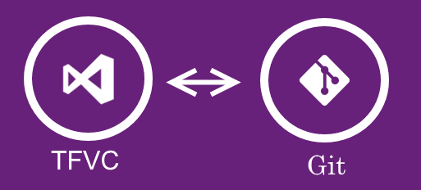












DevOps on Microsoft stack
ITSM
Authentication & Authorization
Audit Control
Dev
Test
UAT
Production
Pull DB Changes
Apply Config changes using CFEngine
DB Change Repository
DEPLOY
Config Repository
Config Management
Apply DB Changes
Deploy Code & Artefact
Apply Config Changes
Trigger for Deployment
Artefact Repository
Web Hooks
Developer
Pull Artifacts from Repository
Branch Code
Code Complete, Send Pull Request
Trigger Next Step on Status or Manually
Push Artifacts
Trigger Deployment
Test Team
Test Team
Operations
Requirements
Product Owner
Merge Code
Shared Repository
Build
Unit Test
Deploy to Dev
Integration Test
Promote Build
Deploy to Test
SIT
Deploy to UAT
UAT
Deploy to Production
User Stories
Code to Requirement Traceability
Code Quality
Continuous Delivery Pipeline
Code Review
Web Hooks
Custom Scripts
Plugins
Code Analysis
Azure Service Bus
Azure Storage
Custom Hooks enabling fetching data from different tools
Custom Hooks
Application
Insight
Logs/Build Data from the tools fed into Log Management
Release Management Dashboard
Customer Support
Collaboration
Log Management Dashboard

